Slide 1
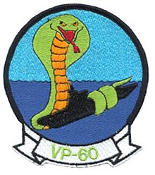

Slide 2
VP-60 REUNION 2024
GREAT LAKES NAVAL TRAINING CENTER

Slide 3
I wonder as I wander………”
“

Slide 4
OUR PAST HISTORY P2V Neptune

Slide 5
OUR (NEAR) PRESENT P-3 Orion

Slide 6
THE ASW FUTURE P-8 Poseidon

Slide 7
THE HONORED FALLEN SHIPMATE TABLE

Slide 8
VP-60 HONORING OUR DEPARTED SHIPMATES
LISTED ARE THE ONES SINCE THE PENSACOLA REUNION 2022

Slide 9
TAPS

Slide 10
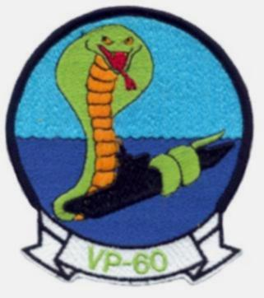
VP-60 Cobras
DONALD MCCLOSKEY BUTCH MICHAELSON NELSON NANCE STEPHEN RICHARDS DOUG SIEBERT GARY TEETERS RICH THOMAS TERRY TREXLER VIRGIL VOIGT RICK WININGAR GARY YOST GEORGE YOUNG Jr. RICHARD ZYCH
LEWIS ABBOTT JIM BOWEN JEAN CARON ED CURRY GARY DAVIS HENRY HARRIS STAN HUFF HOMER MCKEE PETE LINDELL ALAN LOREK HOWARD LYSNE BRUCE “MAC” MCCLELLAN

Slide 11
VP-60 Eternal Patrol

Slide 12
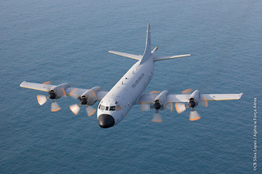
Fair Winds And Following Seas
Shipmates

